Slide 1


Backsplicing analysis in medulloblastoma
Fernando Palluzzi, PhD

Slide 2
1. Backsplicing event calling

Slide 3
Backsplicing (BS) calling scheme
FASTQ
{16 MB, 4 HFB, 5 HAB}
STAR
CIRI
UCSC Known Genes
Chimeric junctions
RO1 (raw junctions)
RefSeq
CIRCExplorer2 (CE2)
bwa-mem
Ensembl transcripts
BS junctions
RO2 (filtered junctions)
Annotator
CE2 ∩ CIRI
3444 hi-confidence BS events

Slide 4
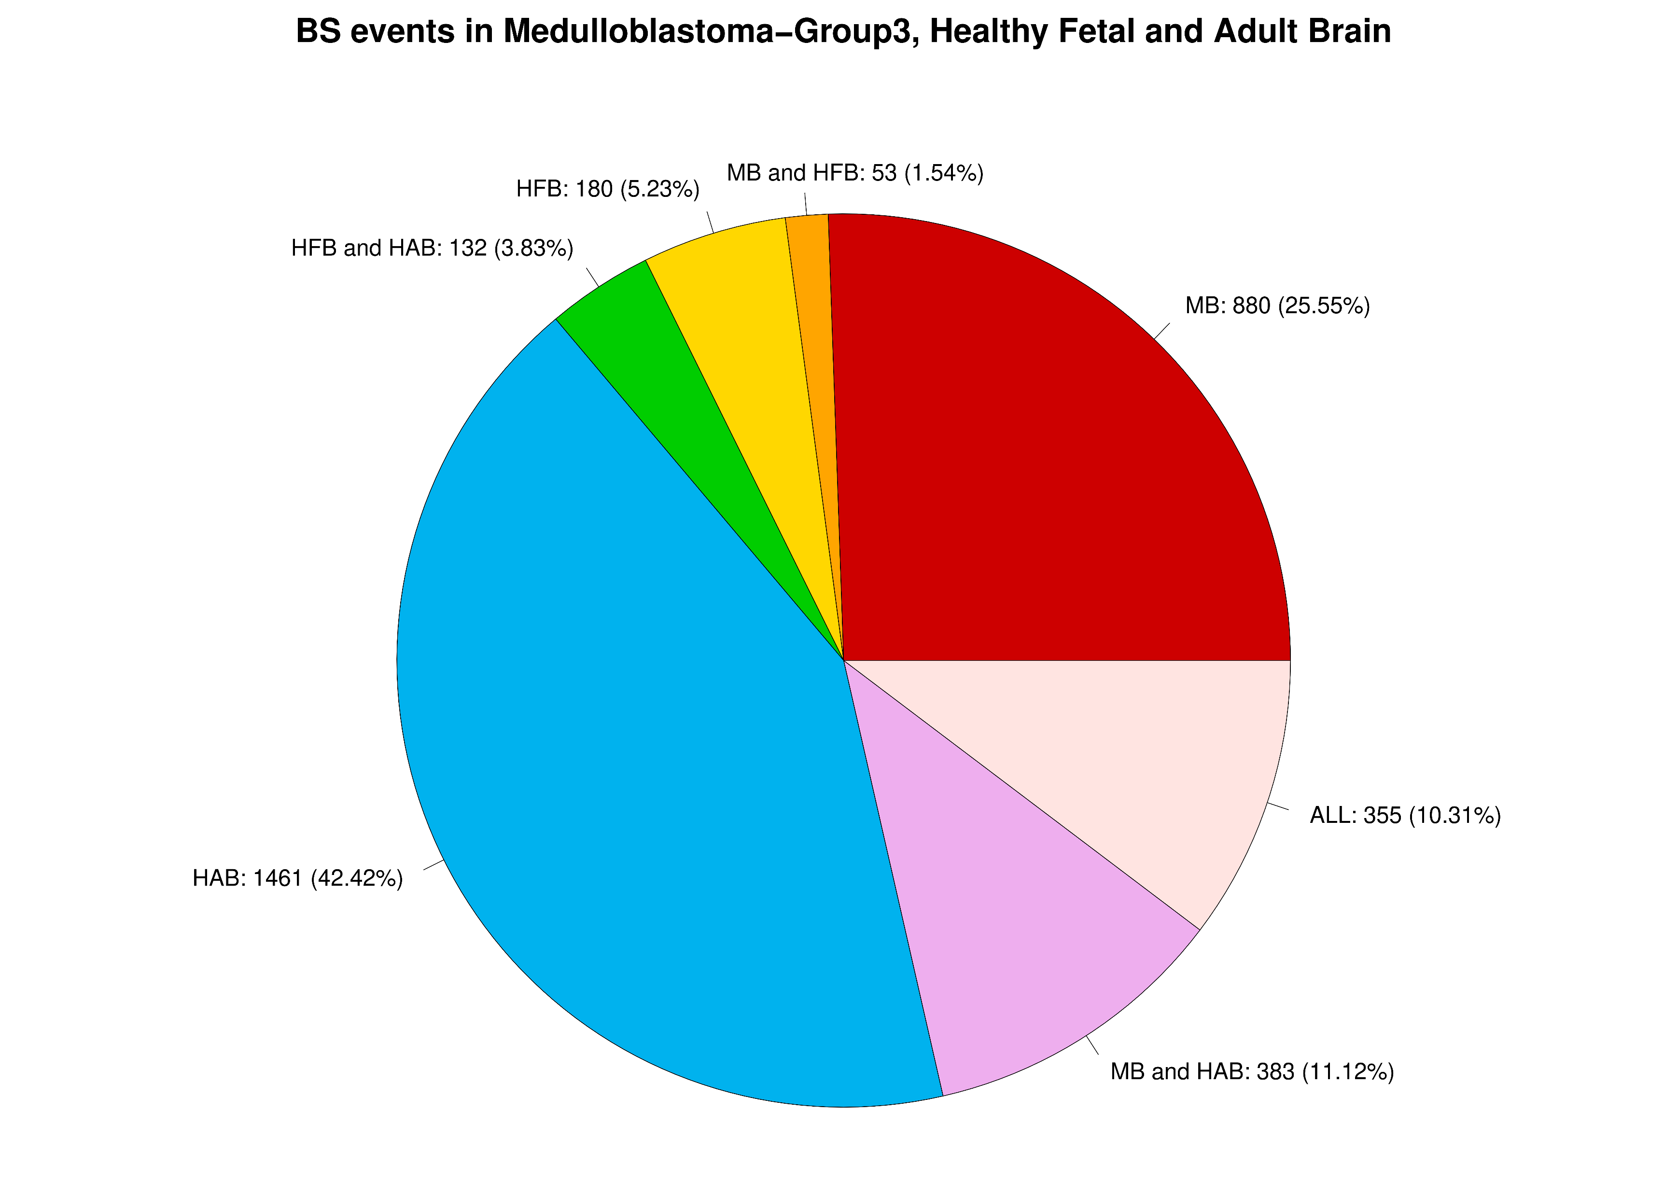
3444 total events
MB: group 3 medulloblastoma
HFB: healthy fetal brain
HAB: healthy adult brain
ALL: common to all phenotypes

Slide 5
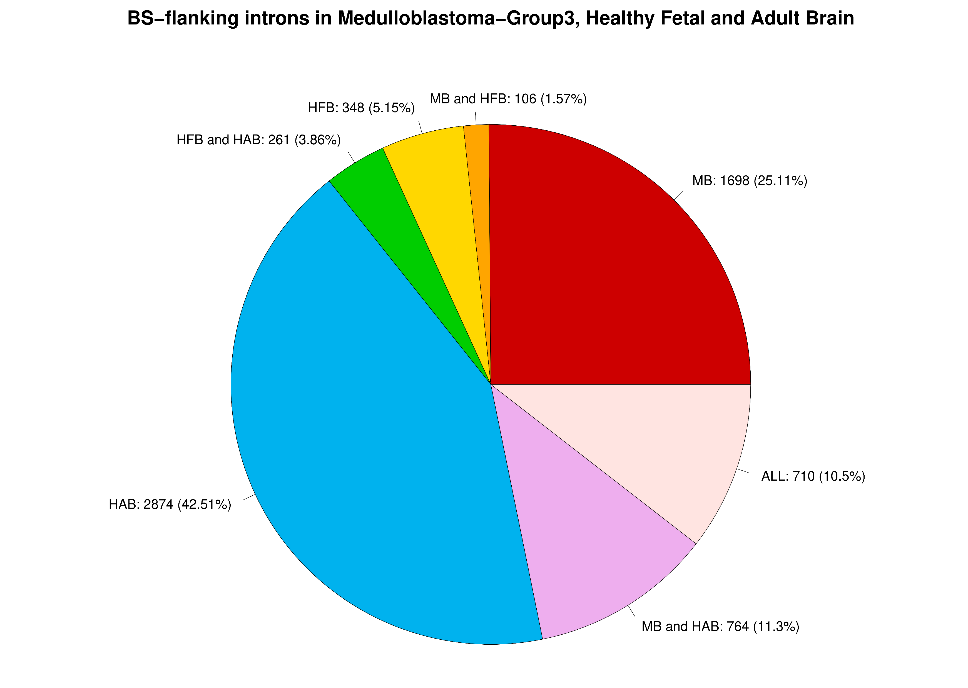
6761 total introns
MB: group 3 medulloblastoma
HFB: healthy fetal brain
HAB: healthy adult brain
ALL: common to all phenotypes

Slide 6
2. Backsplicing-flanking intron length

Slide 7
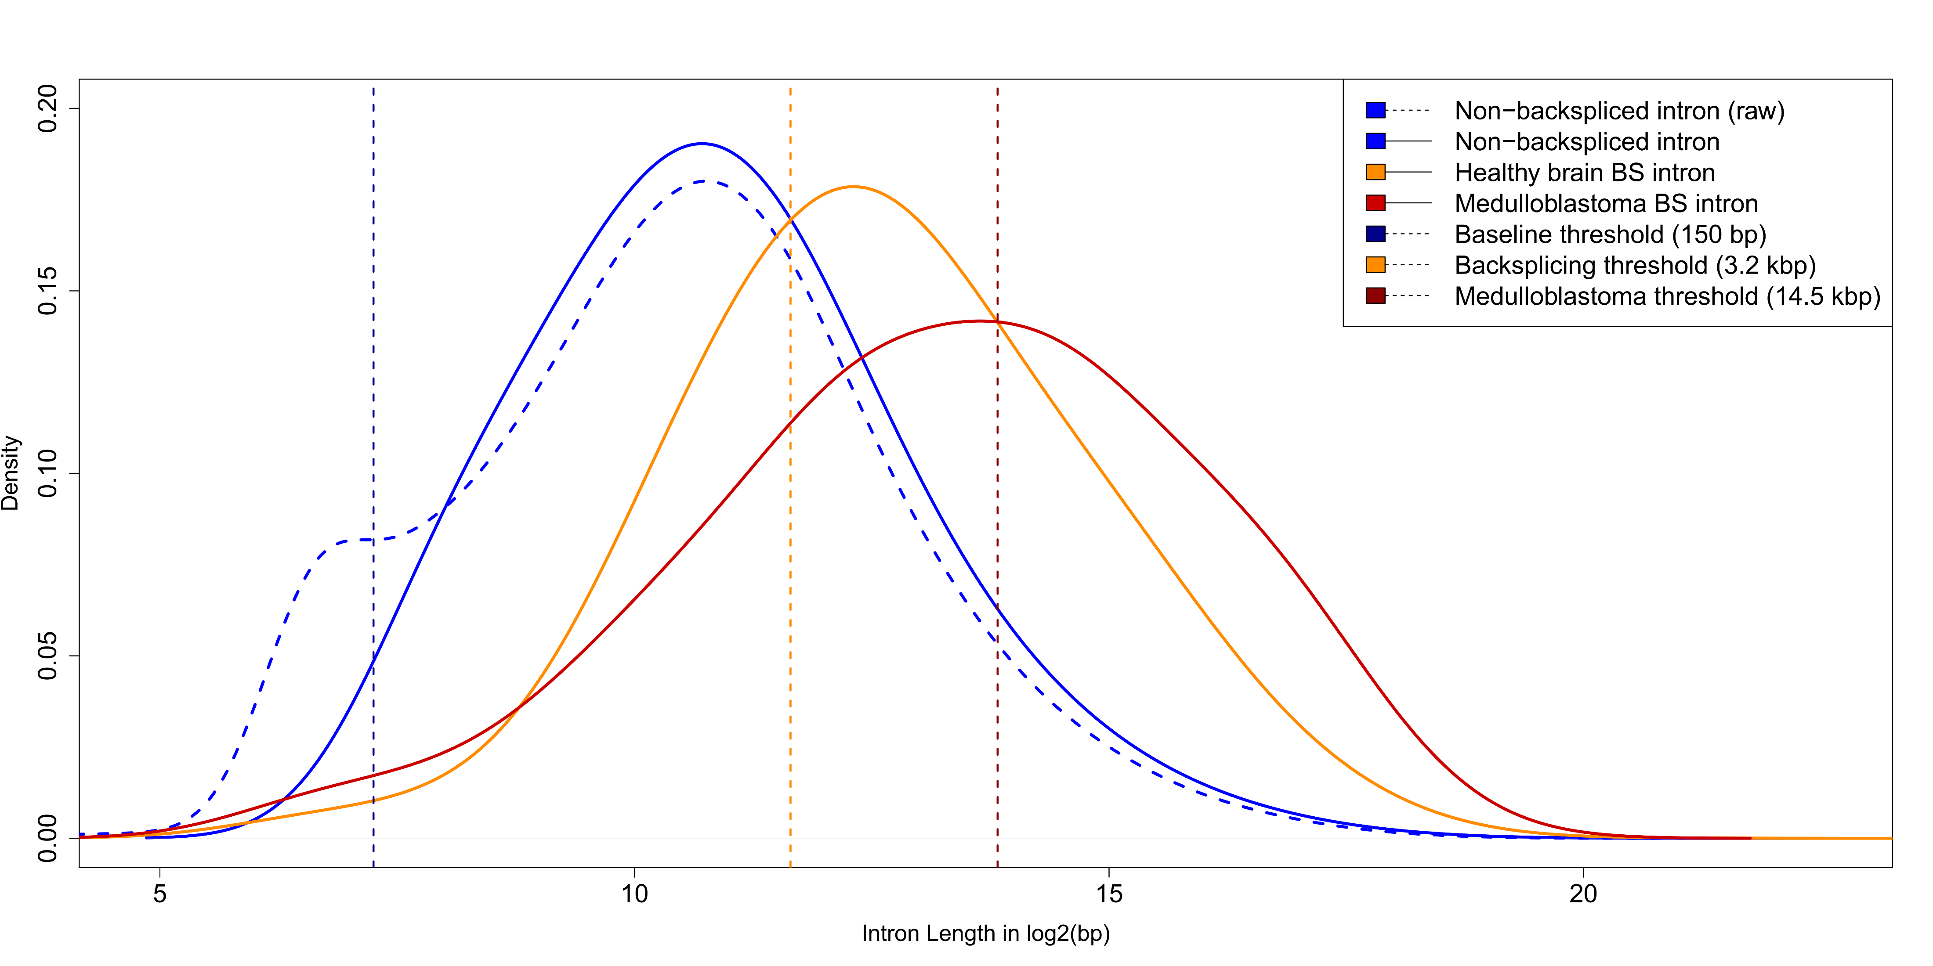
BS-flanking intron length distribution
570323 Non-BS
"background"
introns
1698 MB introns
Very short introns
cause a bimodal
length distribution
348 HFB + 2874 HAB
HB introns have comparable
flanking intron distribution

Slide 8
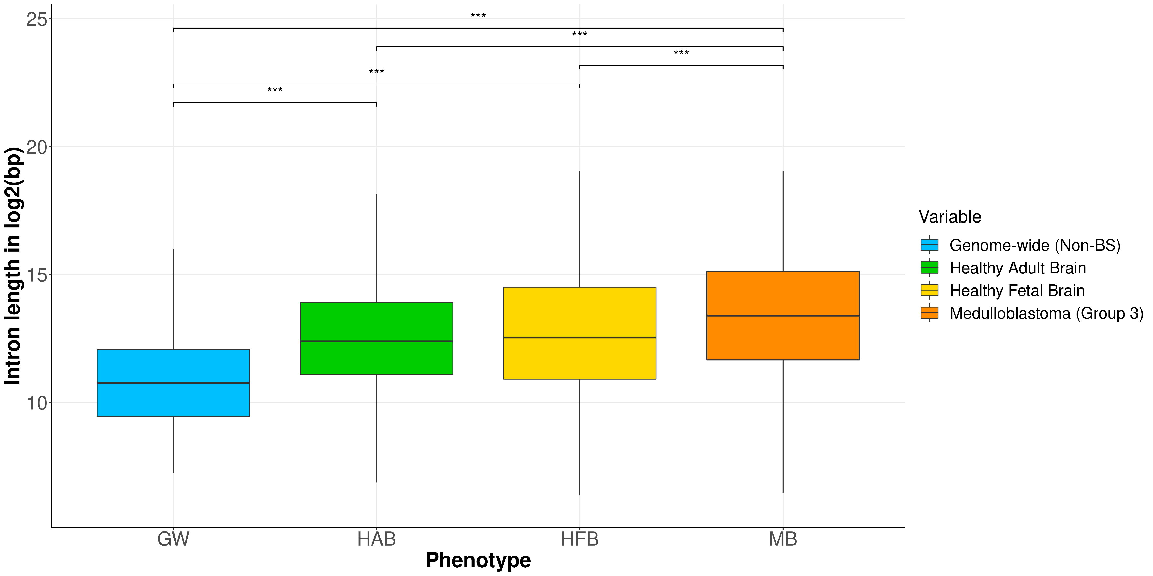
BS-flanking intron length
Two-sided Fisher’s exact test
*** P-value < 1e-05
Non-significant comparisons are omitted

Slide 9
BS-flanking intron length
Contrast | OR | 95% Conf. Interval | P-value
MB vs. HFB | 1.864 | 1.446, 2.416 | 6.66e-07
MB vs. HAB | 2.231 | 1.961, 2.537 | 1.78e-35
MB vs. GW | 7.012 | 6.079, 8.099 | 9.27e-168
HFB vs. HAB | 1.112 | 0.885, 1.398 | 0.3639
HFB vs. GW | 4.343 | 3.499, 5.395 | 2.48e-40
HAB vs.GW | 3.839 | 3.456, 4.265 | 9.33e-133
Two-sided Fisher’s exact test. OR = odds ratio.
All 2x2 contingency matrices, for each test, are built considering introns above/below the
optimal (i.e., max Se, max Sp) length threshold in Group1 vs. Group0.

Slide 10
BS-flanking intron length - results
6761 BS-flanking introns in 3444 backsplicing events.
HFB and HAB subjects show no differences in intron length.
Backsplicing involves longer introns compared to the genome-wide intron distribution.
Backsplicing intron length threshold: ≥ 3.2 kbp
MB subjects show significantly longer BS-flanking introns than healthy brain (HB) subjects.
Medulloblastoma BS-intron length threshold: ≥ 14.5 kbp

Slide 11
3. BS-flanking intron GC content

Slide 12
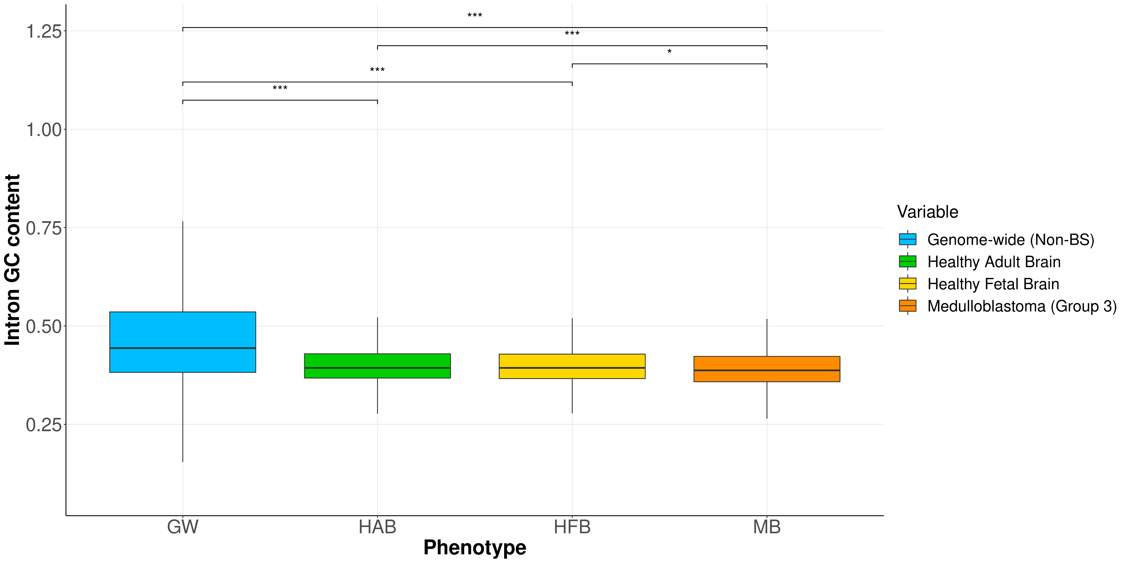
BS-flanking intron GC%
Two-sided Fisher’s exact test
*** P-value < 1e-05
* P-value < 1e-03
Non-significant comparisons are omitted

Slide 13
BS-flanking intron GC%
Contrast | OR | 95% Conf. Interval | P-value
MB vs. HFB | 1.541 | 1.146, 2.095 | 3.37e-04
MB vs. HAB | 1.599 | 1.381, 1.851 | 2.13e-10
MB vs. GW | 5.270 | 4.589, 6.075 | 3.89e-174
HFB vs. HAB | 1.037 | 0.767, 1.387 | 0.8253
HFB vs. GW | 5.191 | 3.827, 7.173 | 9.59e-37
HAB vs.GW | 5.262 | 4.731, 5.865 | 7.63e-292
Two-sided Fisher’s exact test. OR = odds ratio.
All 2x2 contingency matrices, for each test, are built considering introns above/below the
optimal (i.e., max Se, max Sp) GC% threshold in Group1 vs. Group0.

Slide 14
BS-flanking intron GC% - results
A smaller GC content expose introns to backsplicing genome-wide (i.e., genome-wide introns show much higher GC% than backsplicen ones).
MB subjects show BS-flanking intron with significantly lower GC content.
As we will see in the next slides, this expose poor-GC introns to an enrichment in repetitive sequences.
HFB and HAB subjects do not show significant GC% differences.

Slide 15
4. BS-flanking intron Alu enrichment

Slide 16
Alu finding and selection
6761 BS introns (.fa)
EMBOSS inverted repeats finder
Inverted repeats
UCSC repeats (Alu) database
Verified BS-inton Alu dataset
(n = 107267)

Slide 17
BS-flanking intron Alu occurrence
Phenotype | Alu | Alu+ BS introns | BS introns | Avg. per intron *
Total | 107267 | 3175 | 6761 | 15.866
MB | 58403 | 425 | 1698 | 34.395
HFB | 7203 | 107 | 348 | 20.698
HAB | 24516 | 1909 | 2874 | 8.530
MB and HFB | 2548 | 59 | 106 | 24.038
MB and HAB | 7300 | 469 | 764 | 9.555
HFB and HAB | 1078 | 183 | 261 | 4.130
ALL | 6219 | 434 | 710 | 8.759
* Bold entries show a higher average Alu count than the total average number.

Slide 18
BS-flanking intron Alu enrichment
Contrast | OR | 95% Conf. Interval | P-value
MB vs. HFB | 1.330 | 1.022, 1.723 | 0.0317
MB vs. HAB | 5.923 | 5.169, 6.794 | 1.77e-166
HFB vs. HAB | 4.453 | 3.484, 5.721 | 2.95e-37
Two-sided Fisher’s exact test. OR = odds ratio.
All 2x2 contingency matrices, for each test, are built considering Alu+ and Alu- introns in Group1 vs. Group0.

Slide 19
BS-flanking intron Alu repeats - results
MB and HFB phenotype show a higher proportion of Alu repeats than the expected per BS intron (i.e., overall average per BS intron).
MB shows a significantly higher number of Alu repeats than HFB in BS introns.
HAB (and common to HAB) BS introns show significantly less Alu repeats than MB and HFB ones.

Slide 20
5. Differential splicing site usage

Slide 21
BS splicing junction quantification scheme
STAR splicing junctions
Parsing *
Raw quantification
Filtering *
BS junction (BSJ) quantification
* Custom code.
Normalization.
Dispersion estimation.
Differential junction usage:
MB vs. HAB
MB vs. HFB
HFB vs. HAB
edgeR

Slide 22
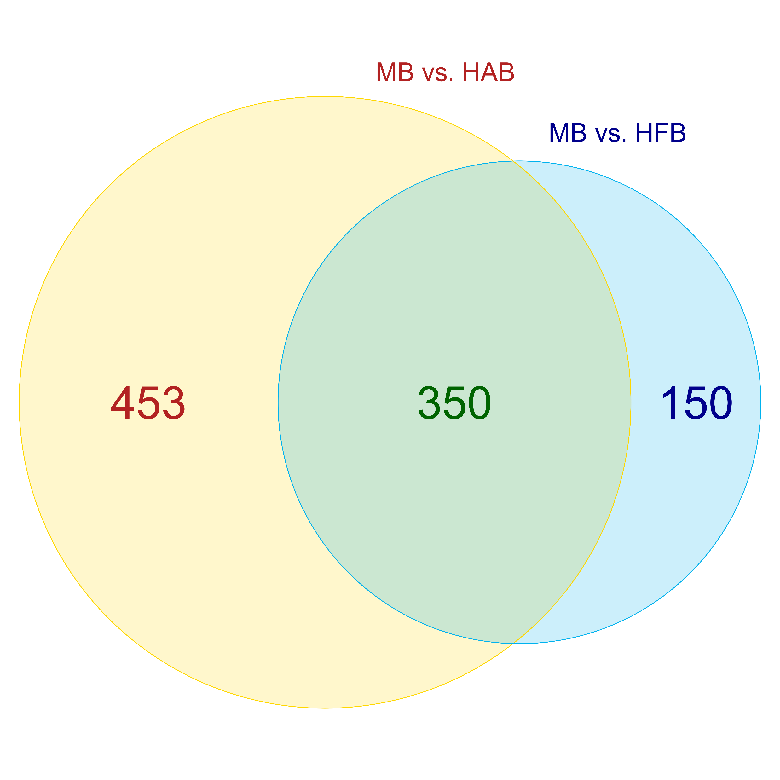
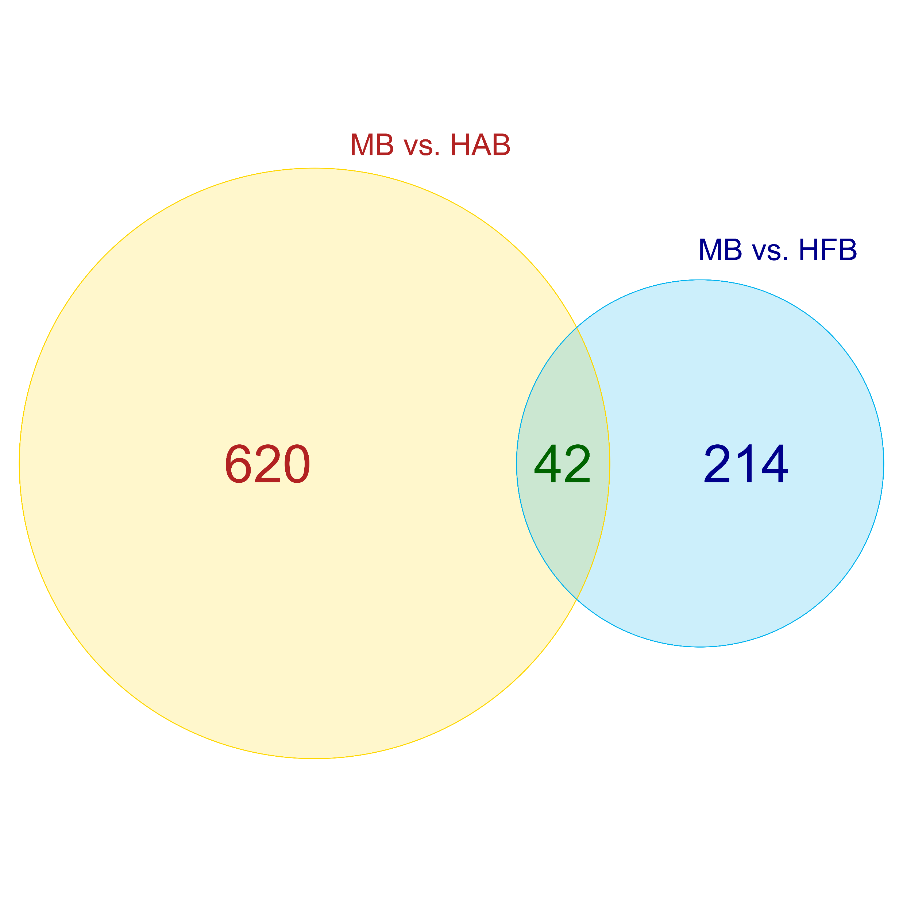
Differential splicing usage at BS introns
Up-regulated BS junctions
Down-regulated BS junctions

Slide 23
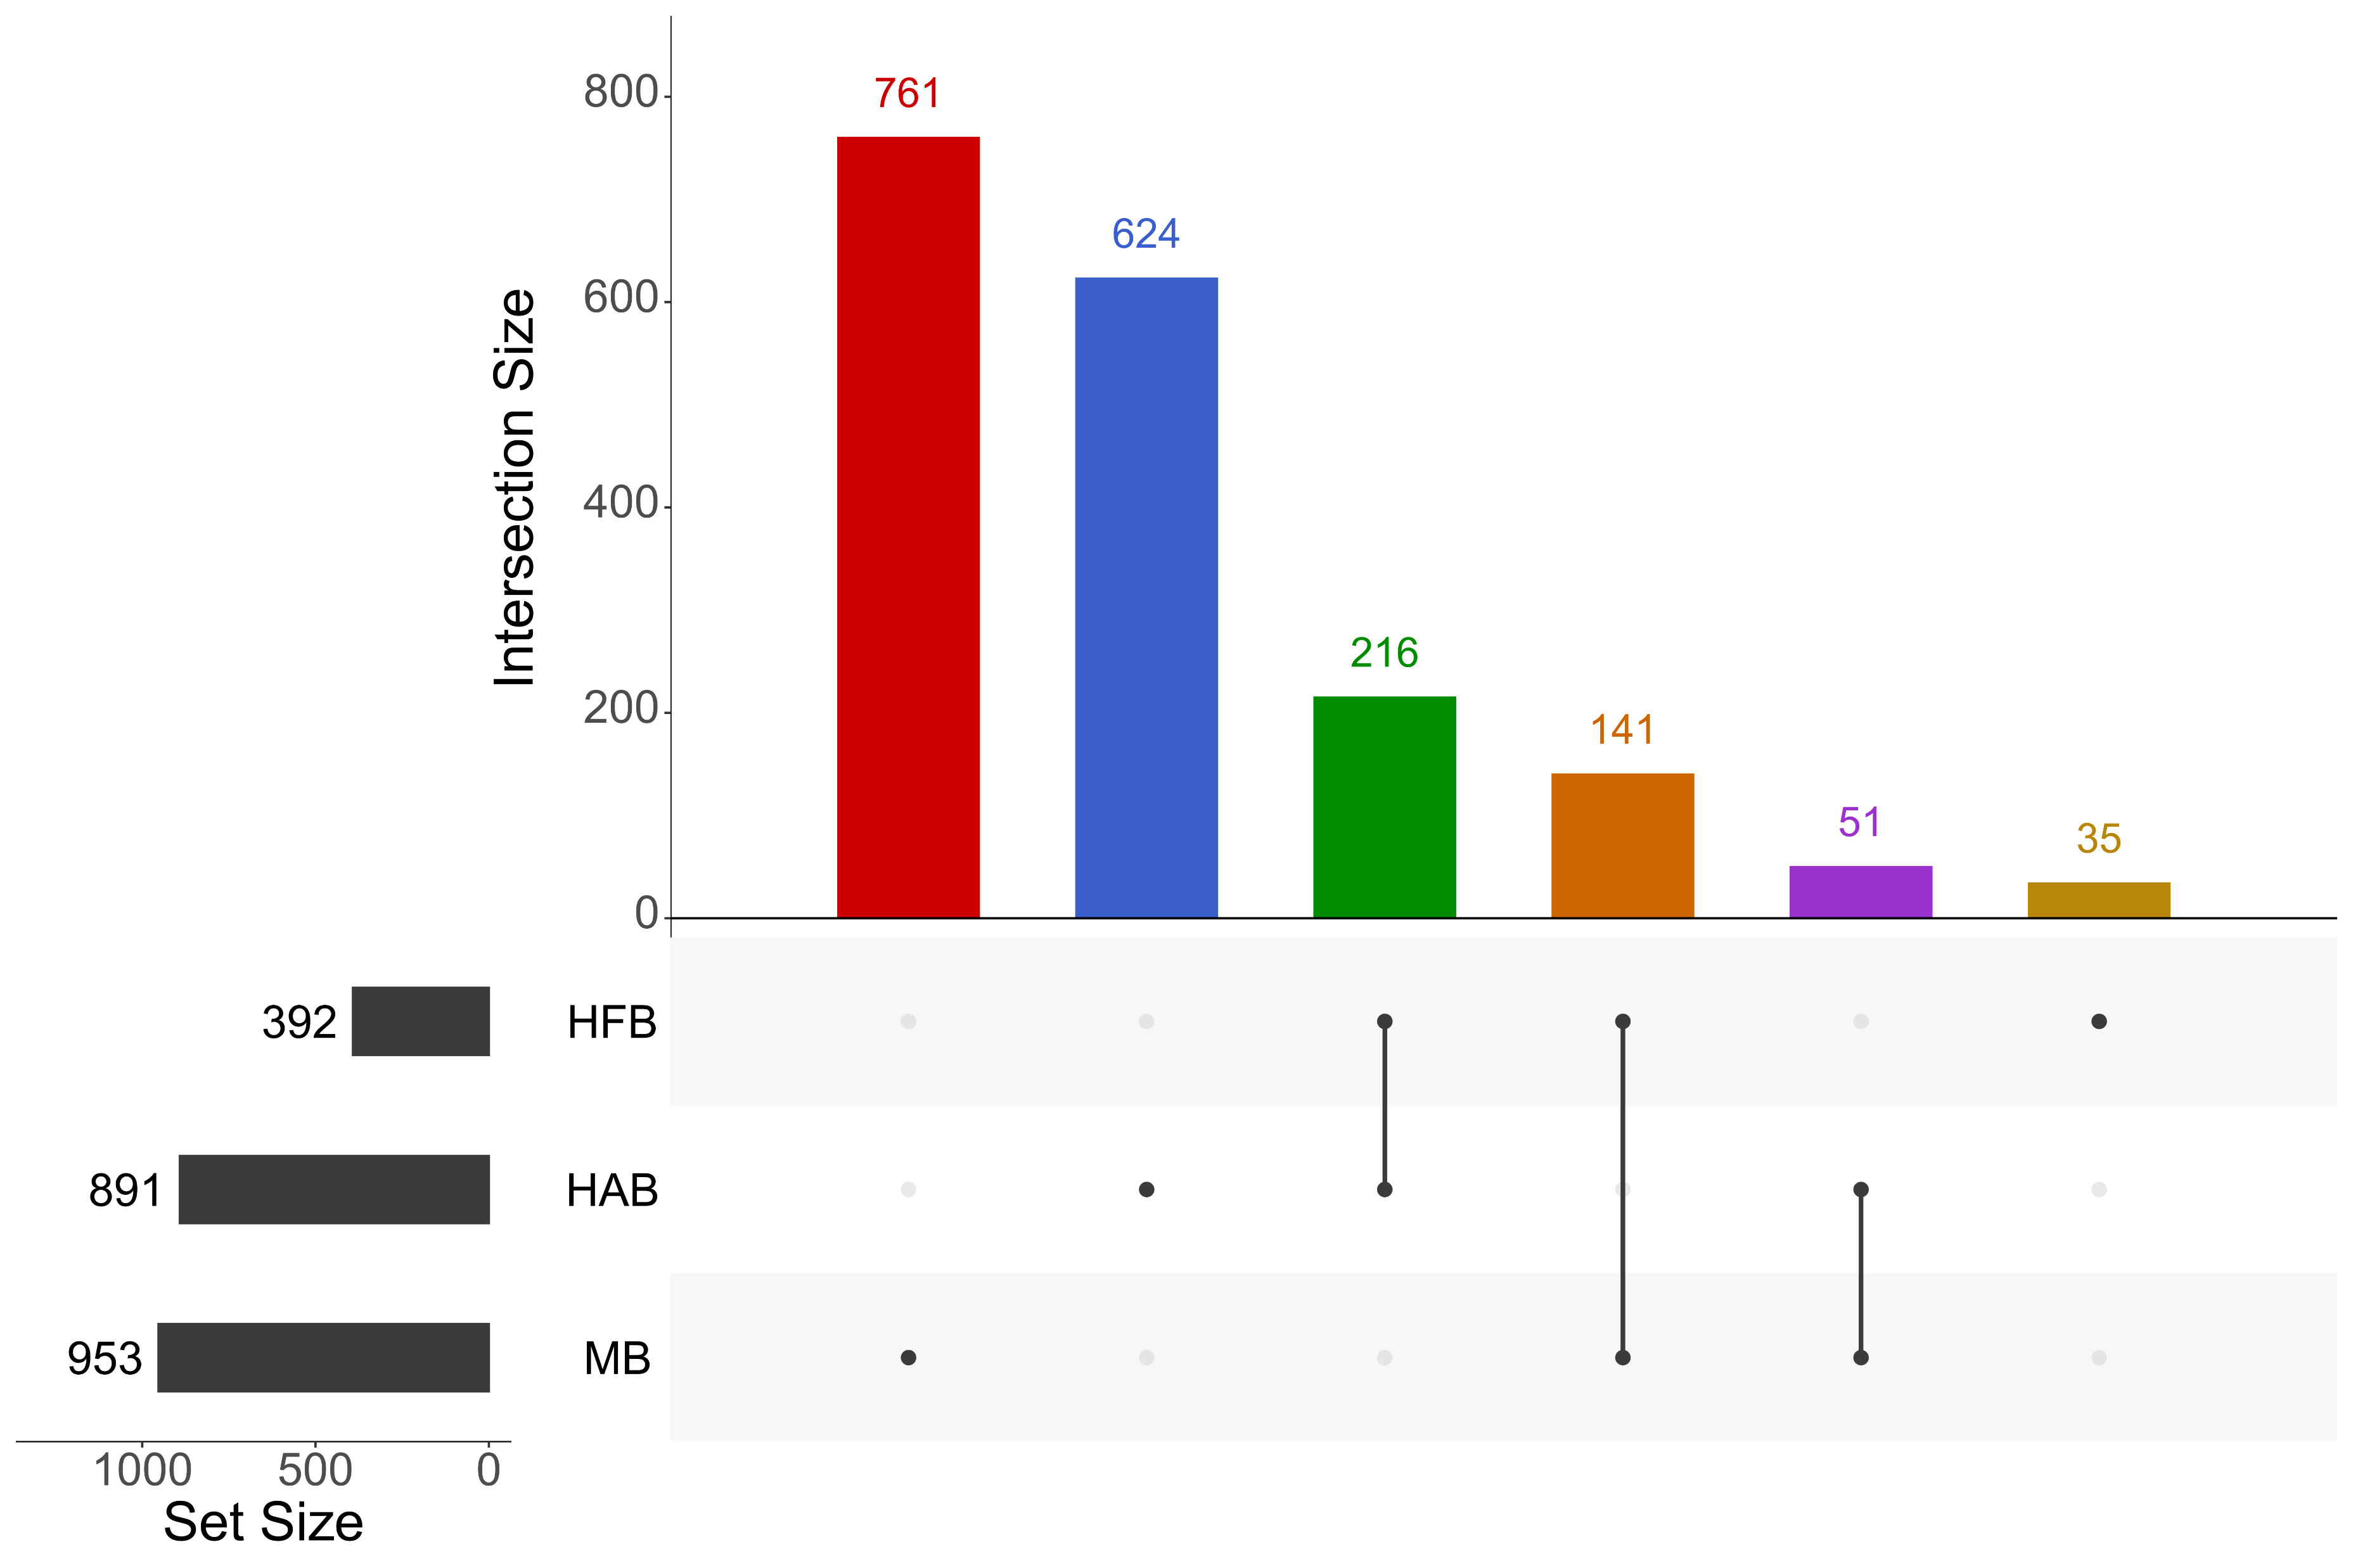
MB-only (HFB/HAB-down)
HAB-only (MB/HFB-down)
HFB-only (MB/HAB-down)
MB and HFB (HAB-down)
MB and HAB (HFB-down)
HFB and HAB (MB-down)
Up-regulated BS junctions

Slide 24
Differential splicing usage at BS+ introns (intron-level analysis)
Contrast | Overspliced | None | Underspliced
MB | 706 | 815 | 177
Non-MB | 810 | 2818 | 1435
HFB | 63 | 193 | 92
Non-HFB | 1453 | 3440 | 1520
HAB | 426 | 1666 | 782
Non-HAB | 1090 | 1967 | 830
6761 introns
6761 introns
6761 introns

Slide 25
Intron BS junction over-usage enrichment
Contrast | OR | 95% Conf. Interval | P-value
MB oversplicing | 3.013 | 2.647, 3.431 | 2.20e-64
MB undersplicing | 0.427 | 0.356, 0.509 | 4.31e-24
HFB oversplicing | 0.773 | 0.568, 1.040 | 0.0912
HFB undersplicing | 1.079 | 0.826, 1.401 | 0.5531
HAB oversplicing | 0.462 | 0.404, 0.526 | 4.74e-33
HAB undersplicing | 1.112 | 0.987, 1.253 | 0.0769
Two-sided Fisher’s exact test. OR = odds ratio.
All 2x2 contingency matrices, for each test, are built considering the number of over (or under) spliced BSJs
per phenotype against non-differentially spliced BSJs.

Slide 26
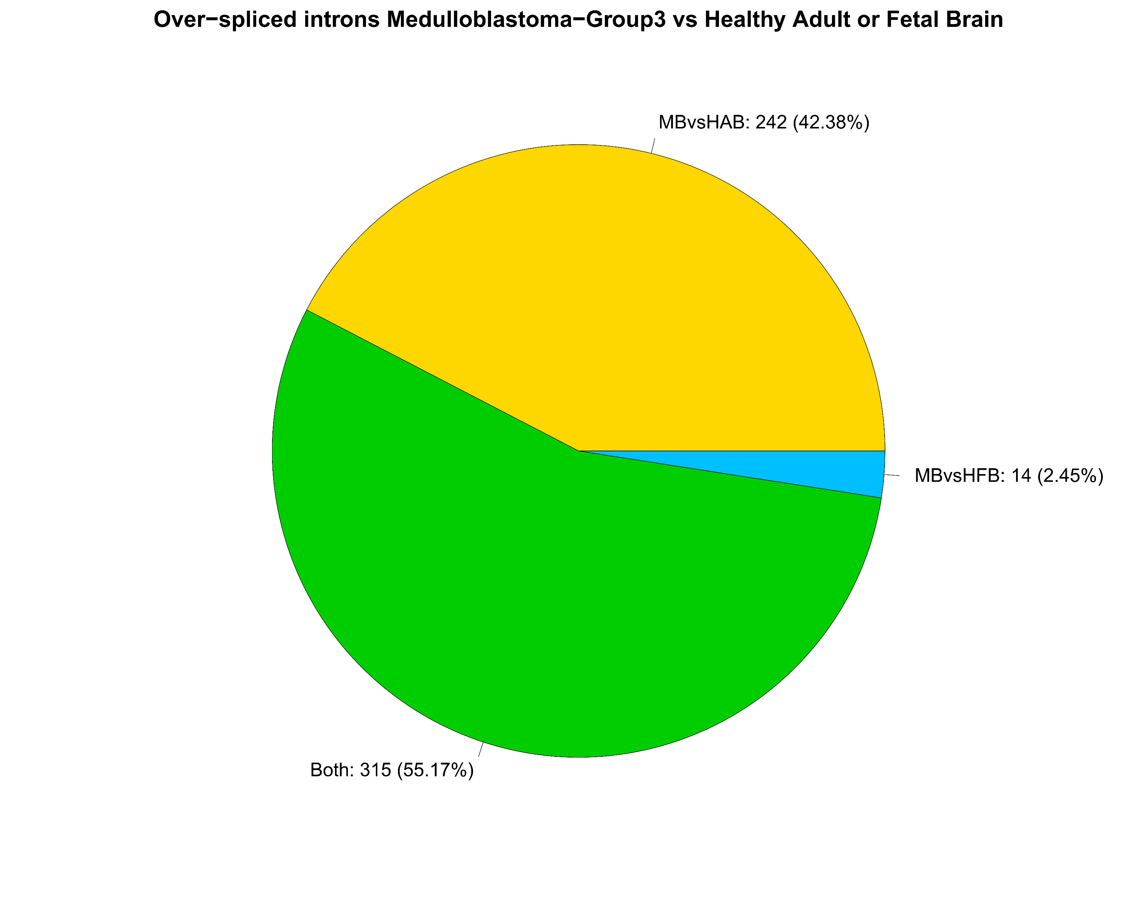
Almost all the over-spliced BSJs in MB vs. HAB
are also over-spliced in MB vs. HFB.

Slide 27
Oversplicing-Gene regulation association
Contrast | Gene regulation | OR | 95% Conf. Interval | P-value
MB vs. HAB | Up-regulation | 12.589 | 9.747, 16.341 | 4.67e-106
MB vs. HAB | Down-regulation | 2.424 | 1.308, 4.390 | 3.34e-03
MB vs. HFB | Up-regulation | 5.043 | 3.919, 6.521 | 5.56e-42
MB vs. HFB | Down-regulation | 0.204 | 0.052, 0.576 | 5.08e-04
Two-sided Fisher’s exact test. OR = odds ratio.
All 2x2 contingency matrices, for each test, are built considering the number of over (or under) spliced BSJs
per phenotype against non-differentially spliced BSJs.

Slide 28
Backsplicing junction (BSJ) regulation - results
Over-usage of BSJs is a typical feature of MB subjects. Enrichment analysis shows 3 times more odds (CI95% = 2.647-3.431, p-value = 2.20e-64) of an overspliced BSJ than in HFB and HAB.
Up-regulated genes in MB versus both HAB and HFB show the highest odds of being over-spliced at BSJs:
149 up-reg over-spliced MBvsHAB DEGs
60 up-reg over-spliced MBvsHFB (all common to MBvsHAB)
139/149 DEGs involve BS events observed only in MB Group3

Slide 29
6. BS regulatory model

Slide 30
Backsplicing-phenotype association
y = f(dT, dQ, L, GCP, Alu)
dT
Differential expression
predictor
Experimental
dQ
Differential splicing
L
Flanking intron length
Phenotype
y = {MB, HFB, HAB}
Structural
GCP
Flanking intron GC%
Alu
Inverted repeats (Alu)

Slide 31
Association model – robust binomial model
Source | Target | log(OR) | SE | z | P-value*
dT | y (outcome) | 0.454 | 0.075 | 6.092 | 1.12e-09
dQ |  | 0.588 | 0.072 | 8.218 | 2.06e-16
L |  | 0.178 | 0.036 | 4.909 | 9.15e-07
GCP |  | -0.081 | 0.034 | -2.365 | 0.0180
Alu |  | 0.947 | 0.068 | 13.946 | 3.34e-44
Transcription
Splicing
Intron length
GC%
Alu repeats
* Two-sided z-test, with robust bootstrap standard errors (SE) estimation (B = 5000)
Rounded values to the third decimal point are reported for estimate, SE and z.
Variable encoding:
y = 1 if phenotype == "MB", 0 otherwise;
dT = 1 if MB vs. HAB up-regulated or MB vs. HFB up-regulated, 0 otherwise;
dQ = 1 if MB vs. HAB overspliced or MB vs. HFB overspliced, 0 otherwise;
L = log2(BS intron length) **;
GCP = BS intron GC% **;
Alu = 1 if intronic Alu > 0, 0 otherwise. ** normality transform

Slide 32
Association model – possible further analyses
Machine-learning based validation of the robust binomial model predictors (dQ, dT, L, GCP, Alu).
Pathway perturbation and regulatory network estimation.

Slide 33
7. BS functional analysis

Slide 34
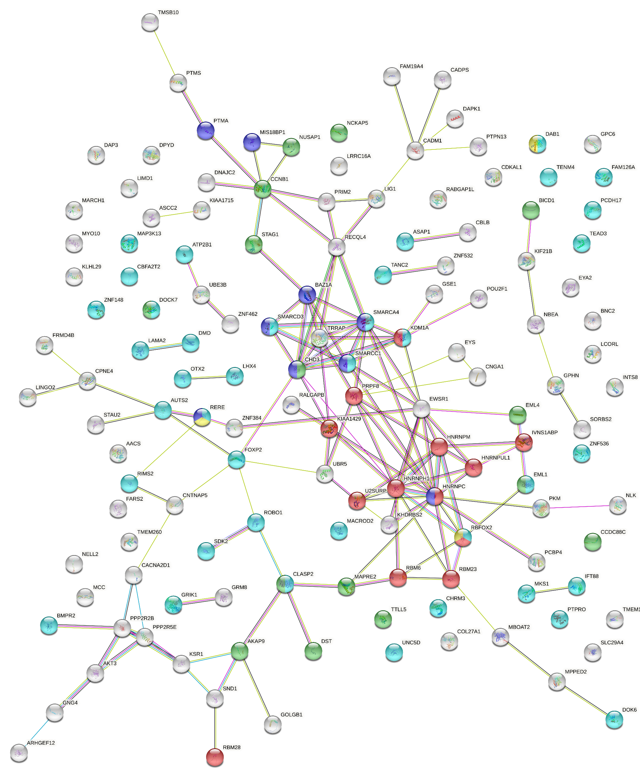
STRING PPI network
149 up-reg low-GC Alu-enriched DEGs are extracted from 434 BS overspliced introns.
GO-BP enrichment:
Nervous system development (39 DEGs, FDR = 0.0040)
Microtubule cytoskeleton (15 DEGs, FDR = 0.0119)
RNA splicing (13 DEGs, FDR = 0.0159)
Purkinje cell migration (3 DEGs, FDR = 0.0212)
Chromatin remodeling (9 DEGs, FDR = 0.0244)

Slide 35
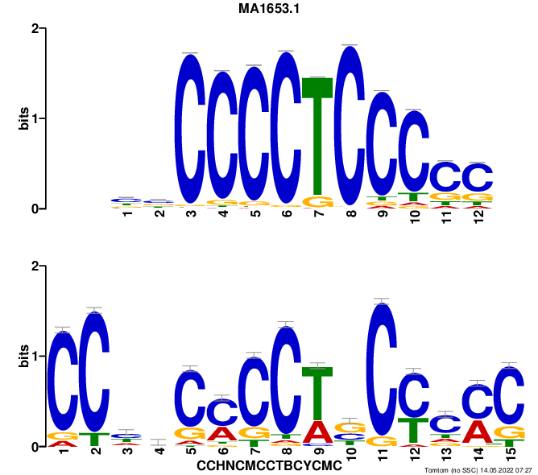
Top-enriched MEME motif in MB BS introns
ZNF148
MA1643.1 motif
q-value = 2.08e-03
Consensus intronic sequence
(CCHNCMCCTBCYCMC)
ZNF is one of the 149 Up-regulated Low-GC Alu-enriched Overspliced enriched in the GO-BP list (nervous system development).

Slide 36
Up-regulated Low-GC Alu-enriched RNA-binding proteins (UNIPROT enrichment)
RNA-binding protein | Up-DEG | Low-GC | Alu | Over-SJ | Splicing regulation
HNRNPM | + | + | + | + | +
HNRNPUL1 | + | + | + | + | +
HNRNPC | + | + | + | + | +
HNRPH1 | + | + | + | + | +
RBM6 | + | + | + | + | +
RBM23 | + | + | + | + | +
RBM28 | + | + | + | + | +
RBFOX2 | + | + | + | + | +
PRPF8 | + | + | + | + | +
U2SURP | + | + | + | + | +
EWSR1 | + | + | + | + | -
KHDRBS2 | + | + | + | + | -
PCBP4 | + | + | + | + | -
SMARCA4 | + | + | + | + | -
STAU2 | + | + | + | + | -
All the UNIPROT
RNA-binding proteins
Present in the STRING
PPI network.

Slide 37
Functional analysis - results
149 up-regulated backsplicing target DEGs are involved in nervous system development, microtubule cytoskeleton organization, RNA splicing, chromatin remodeling, and radial glia guided migration of Purkinje cell.
Among them, ZNF148 is the top enriched MEME motif in the 434 MB BS-target introns.
Uniprot enrichment analysis yielded 15 RNA-binding proteins, 10 of which are involved in splicing regulation.

Slide 38
8. Characterization of the 149 MB-target DEGs

Slide 39
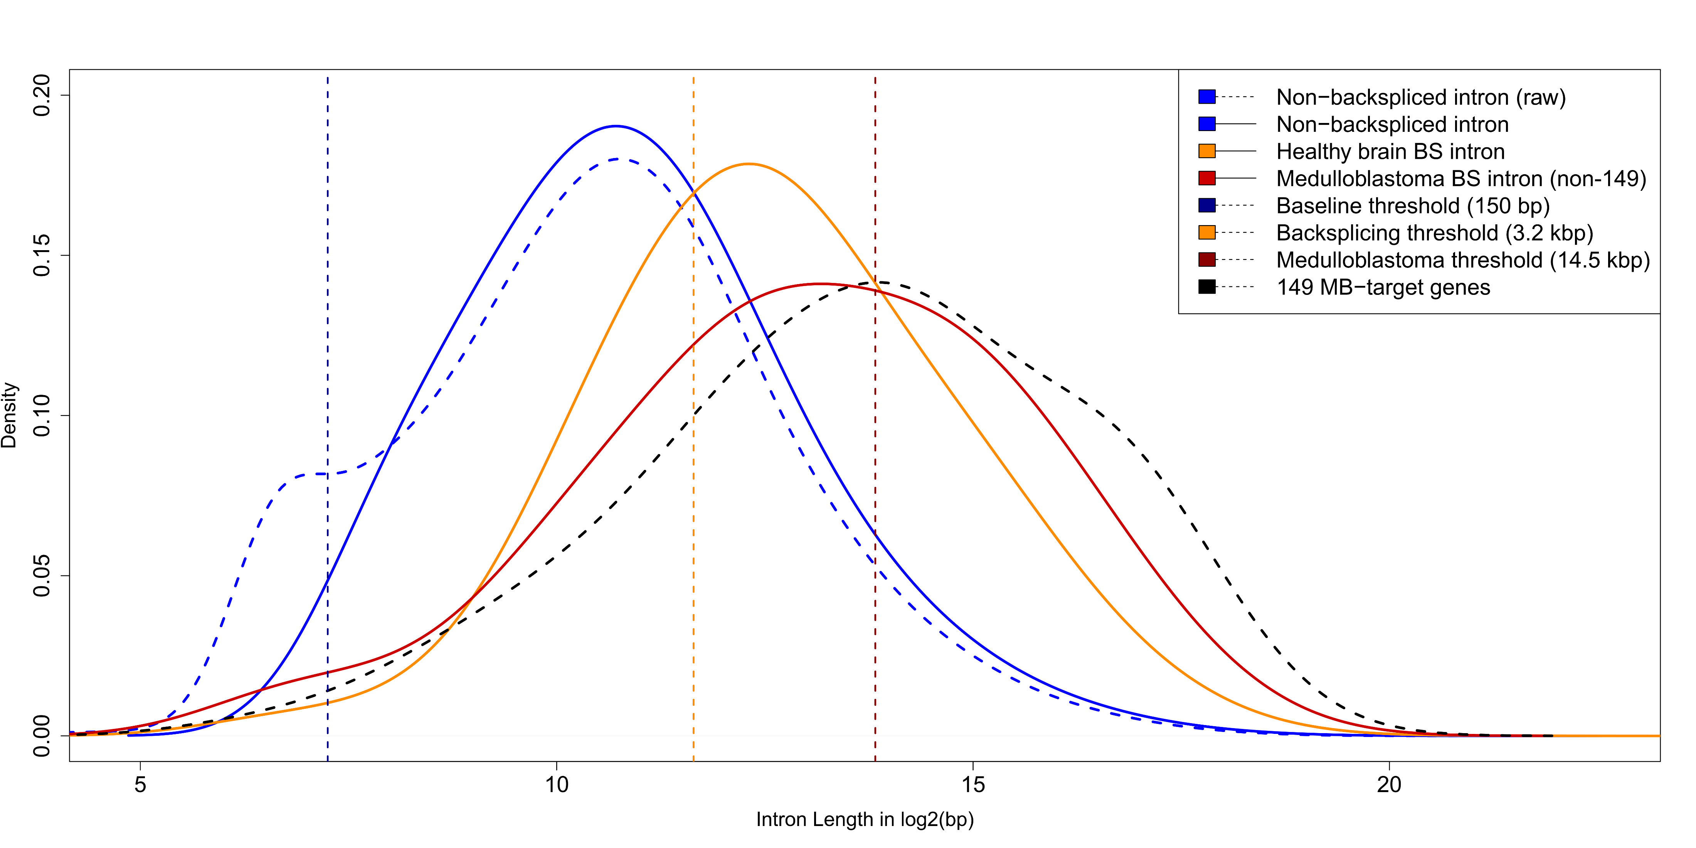
BS-flanking intron length distribution
MB 149 vs. MB non-149
ΔL = +2.723 kbp
CI95% = 1.446-4.106 kbp
P = 2.23E-06

Slide 40
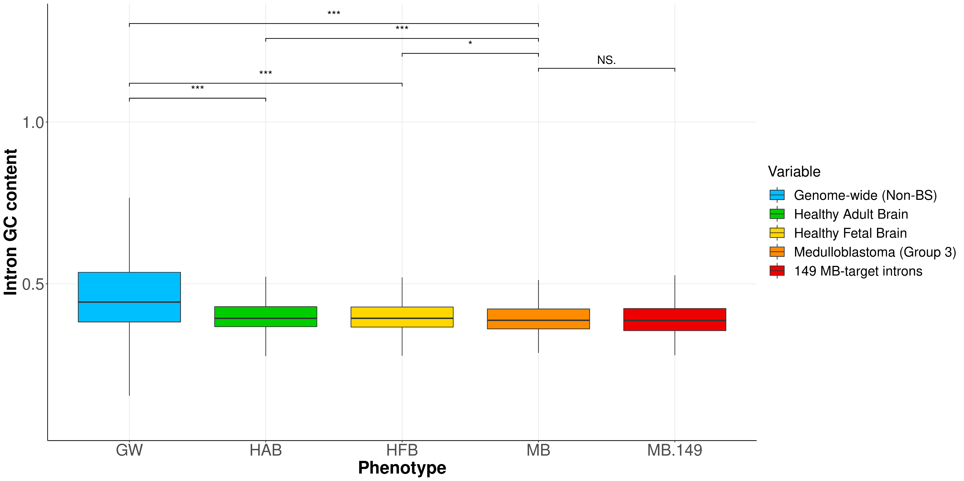
BS-flanking intron length distribution
MB 149 vs. MB non-149
ΔGCP = -0.0047 %
CI95% = -0.0102, 0.0004 %
P = 0.0771

Slide 41
Alu proportion (MB 149 vs. MB non-149)
Group | Proportion* | Δp | 95% Conf. Interval | P-value**
MB 149 | 54.08% | +9.85% | 4.93, 14.77 % | 7.54E-05
MB non-149 | 44.23%
* Proportion of introns showing at least m = 6 Alu repeats (m is the max-sensitivity/max-specificity threshold
optimizing the classification between MB 149 and MB non-149 on the base of Alu frequency).
** X-squared = 15.67, df = 1.

Slide 42
Backsplicing and transcriptional enrichment (MB 149 vs. MB non-149)
Variable | Observed effect | Δ* | 95% Conf. Interval | P-value
Backsplicing | Up in MB 149 | +2.244 | 2.057, 2.451 | 9.28e-143
Transcription | Up in MB 149 | +1.920 | 1.809, 2.084 | 1.64e-234
* Δ = log₂FC(MB 149) – log₂FC(MB non-149);
for backsplicing: Δ = ΔQ = BS junction usage difference;
for transcription: Δ = ΔT = BS+ DEG transcriptional difference.

Slide 43
149 MB-target DEGs
Respect to non-149 DEGs, the 149 MB-targets show:
Longer introns (ΔL = +2.723 kbp).
Higher proportion of Alu-enriched introns (Δp = +9.85%).
Higher BS junction usage (ΔQ = +2.244).
Higher transcriptional level (ΔT = +1.920).
Same intronic GC% (ΔGCP = -0.0047%).

